Slide 1
OWN YOUR CAREER
Electronics and Communication Engineering
Prepared By
Bismi M. Ismail, Neethu Prakash, Sangeetha G.S., Steena Maria Thomas,
Shajin Shajahan, Aruna Raj P.R. and Pooja P. Anil.

Slide 2
“Electronics and Communication Engineering deals with the electronic devices and software applications. It is an interface of chip level hardware and information technology”
One of the largest and fastest growing field of engineering
Covers a wide range of applications such as television, radio, computers, telecommunication etc., which make our life easier and enjoyable

Slide 3
After B tech, What next?
B.TECH
JOBS
CORPORATE JOBS
GOVERNMENT JOBS
HIGHER EDUCATION
MASTERS
ENTREPRENEURSHIP
TEACHING
RESEARCH/PhD
JOBS
JOBS
HARDWARE
SOFTWARE

Slide 4
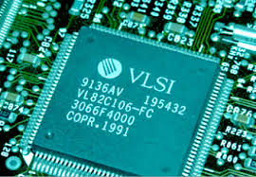
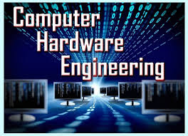
MAJOR CORE FIELDS
ELECTRONICS
DESIGN
SIGNAL
PROCESSING
COMMUNICATION SYSTEMS

Slide 5
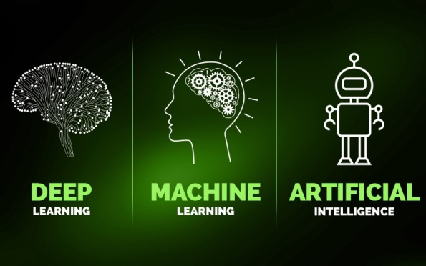
RECENT TRENDS
Artificial intelligence : Sometimes
called machine intelligence,
is intelligence demonstrated by machines
Internet of Things (IoT) : An ecosystem of connected physical objects that are accessible through the internet
Industrial Automation : Deals primarily with the automation of manufacturing, quality control and material handling processes

Slide 6
Do you possess these skills? Then opportunity knocks you easily
JOB CATEGORY | REQUIRED SKILL SET | JOB OPENINGS
VLSI | VERILOG AND VHDL | VLSI JOBS
CIRCUIT DESIGN | ELECTRONIC CIRCUIT DESIGN PROCESS | CIRCUIT DESIGN JOBS
CHIP DESIGN | TRANSISTOR PROCESS TECHNOLOGY, MICROPROCESSORS | EMBEDDED JOBS
MOBILE COMMUNICATIONS | NETWORK SWITCHING, COMMUNICATION BASICS, VOICE OVER INTERNET PROTOCOLS AND INTERACTIVE VOICE RECOGNITION | TELECOM JOBS LIKE RF ENGINEER
IMAGE AND SIGNAL PROCESSING | SPEECH ANALYSIS AND SYNTHESIS,MATLAB,AI AND DEEP LEARNING | CODING DEVELOPER, STRATEGIC AND ROBOTICS

Slide 7
PUBLIC SECTOR JOBS – WRITTEN TESTS
STATE GOVERNMENT
Legal Meteorology,
PWD, KEL, KSEB
Engineer and scientist jobs in Keltron
CENTRAL GOVERNMENT

Slide 8
MAJOR PUBLIC SECTOR
UNDERTAKINGS

Slide 9
MAJOR PRIVATE SECTOR COMPANIES

Slide 10
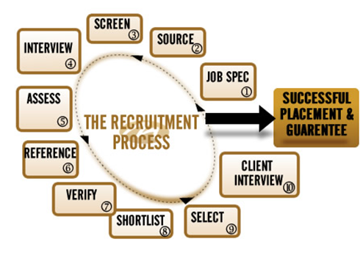
Each company have their
own recruitment process
RECRUITMENT
APTITUDE TEST
GROUP DISCUSSION
TECHNICAL INTERVIEW
PERSONAL INTERVIEW

Slide 11
ENTREPRENEUR
- Be Your own Boss

Slide 12
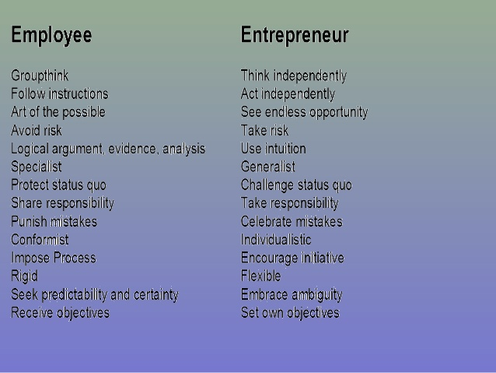

Slide 13
TEACHING PROFESSION
SKILLS REQUIRED
Communication
Presentation skills
Passion for teaching
Should be patient and calm enough to deal with students.
Lifelong Learning
HOW TO GET JOB ???
UGC-NET(national entrance test) in order to become lecturer in Government Engineering Colleges.

Slide 14
MTECH
MBA
INTEGRATED MTECH - PhD
ABROAD MS
PhD

Slide 15
Post graduation degree in engineering
Duration - 2 years
Qualifying Examination-GATE
plus at least 60 per cent marks in the
B. Tech course
Specialisations :
Embedded systems
Bioinformatics
Digital systems and communication
Digital signal processing
VLSI design
Nanotechnology
Opto-electronics
Cyber security
Software engineering
An all-India examination that primarily tests the comprehensive understanding of various undergraduate subjects in engineering and science

Slide 16
Post-graduate level degree that imparts a strong theoretical foundation in business and management
Few MBA specializations in India
MBA in Finance.
MBA in Marketing
MBA in Human Recourse (HR)
MBA in International Business
(IB)
MBA in Operation Management.
MBA in Information Technology
(IT)
MBA in Supply Chain
Management
MBA in Rural Management
One has to clear CAT examination to join MBA course at Top Institutes
Top MBA Colleges in India
Indian Institute of Management (IIMs)
Indian Institute of Technology (IITs)
Xavier school of management, Jamshedpur
Management Development Institute, Gurgaon
Faculty of Management Studies, University of Delhi, Delhi

Slide 17
Integrated M.tech - PhD
Various institution provides integrated M.tech – PhD for B.tech graduates
IIT Guwahati
Link – www.iitg.ac.in
CSIR – CMERI
Duration – 5 yrs
Link – www.cmeri.res.in
IIA, Indian Institute of Astrophysics
Duration – 6 yrs
Link – www.iiap.res.in
IISc Bangalore
Link – www.iisc.ac.in

Slide 18
PhD-Doctor of Philosophy
The highest academic degree awarded by universities in most countries
Highest level of degree that a student can achieve

Slide 19
If you wish to opt for MS in engineering, you can choose to write Graduate Record Examinations (GRE ) or the Graduate Management Admission Test (GMAT)
Additionally, you would also have to take the International English Language Testing System (IELTS)/ Test of English as a Foreign Language (TOFEL) to demonstrate your proficiency in English
Most institution accepts a score of 6.5 on the IELTS to grant admissions.
The GRE scores that popular institution accept range from 310 to 335

Slide 21
OUR TOP RECRUITERS
SI. No. | Company | Area related to ECE Core
1 | CISCO | Wireless, Networking
2 | HCL | Analog and Digital Electronics, Embedded System
3 | INFOSYS | Analog and Digital Electronics, VLSI
4 | INTEL | Analog and Digital Electronics
5 | TATA ELXI | Embedded design, Analog and Digital Electronics, Networking, Wireless Communication
6 | TCS | VLSI, Analog and Digital Electronics
7 | VVDN | Embedded design, Networking, Wireless Communication
8 | WIPRO | VLSI, Embedded system ,Communication

Slide 22
ALUMNI
GOVERNMENT
Shammy P S - Airports Authority Of India
Lt Bibin C Varghese - Indian Navy
Jobin Mathews - Indian Meteorological Dept.
Dinesh R - Indian Railways
Antony O T - Indian rare earths Ltd
Anwar K Backer - Indian Space Research Organisation
Arun G - Nuclear Power Corporation of India Ltd
Rakesh S R - Bharat Sanchar Nigam Limited
PRIVATE
Shaji CR - Intel
Jobin Jose Sebastian - Cisco Systems
Reshmi R - Cypress Semiconductor
Tom Mathews - Qualcomm Inc.
Samir Muhammad - Tech Mahindra
Alien Donal - Samsung R&D Institute Bangalore India
Kamchalabdhan TT - Magnum Networks Support Pvt. LTD

Slide 23
CAREER LINKS
Intel
http://www.intel.com/content/www/us/en/jobs/locations/india.html
Indian Navy
http://nausena-bharti.nic.in/career.php
Wipro
http://careers.wipro.com/
Siemens https://jobs.siemens-info.com/jobs
Bosch https://careers.smartrecruiters.com/BoschGroup/india
Philips https://www.careers.philips.com
Texas Instruments https://careers.ti.com/search-jobs/
Employment News
http://employmentnews.gov.in/NewEmp/Home.aspx

Slide 24
Some Useful Links
Confederation of Indian Industry, Kerala
http://www.cii.in/States.aspx
Technopark, Trivandrum
http://www.technopark.org
Infopark, Kochi
http://www.infopark.in/
Startup Village
https://www.sv.co/?redirect_from=startupvillage.in
Centre for Engineering Research and Development, Govt of Kerala
http://www.dtekerala.gov.in/index.php/en/home/root/institutionsprogrammes/research- programmes-in-engineering-colleges/cerd

Slide 25
Several Electronics jobs https://careers.electronicsforu.com/
iBall https://www.iball.co.in/Careers
HCL https://www.hcltech.com/careers#careers_opportunities
Amkette https://www.amkette.com/careers/#opening-position
Bel http://bel-india.in/CareersGridbind.aspx?MId=29&LId=1&subject=1&link=0&issnno=1&name=Recruitment%20-%20Advertisements
Cisco https://jobs.cisco.com/jobs/SearchJobs/?source=Cisco+Jobs+Career+Site&tags=CDC+SnNG+students-and-new-graduate-programs

Slide 26
INSTITUTION & DEPARTMENT HIGHLIGHTS
National Board of Accreditation (NBA) Accredited Courses
One of the Top 5 Technical Institutions In State according to KTU ranking
3rd Rank In First Year KTU Results and top ranker in GATE.
Full-fledged library containing international research journals, magazines and materials for civil service preparation.
Full-fledged laboratory containing various communication devices and antenna parts designing.
Core company recruitment.

Slide 27
ELECTRONICS & COMMUNICATION DEPARTMENT
Research lab exclusively for speech processing funded by Govt. Of Kerala.
Well knowledgeable faculties in various fields.
Conducting talks and seminars on various subjects and thesis contests.
Courses :B..Tech and Phd.
M.tech in Advanced Electronics and Communication Engineering and M.Tech in Advanced Information and Communication Systems.
Industrial Projects and Internship providing assistance in reputed central and state govt. Companies like IIST, IIT Madras, NISH, AIISH, ENTUPLE, Doordarshan, BSNLetc.
Providing assistance in Start-Ups

