Slide 1
CAREERS: WHAT NOW?
COMPUTER SCIENCE ENGINEER
Prepared by Ahmed Rehman, Adharshya P, Cheril Mariam John

Slide 2
AFTER B.TECH?
MBA
M.TECH
JOB
M.E
M.SC
GATE
M.PHIL
PhD

Slide 3
Are you looking for a JOB?
GOVT JOBS
PRIVATE JOBS

Slide 5
PUBLIC SECTOR & GOVT JOBS!!!
IES
INDIAN
RAILWAY
AAI
SAIL
PSC
BEL
ISRO
ONGC
RRB
FCI
BHEL
IBPS
UPSC

Slide 6
WHAT IF I NEED A PRIVATE JOB?
MICROSOFT
WIPRO
IBM
ORACLE
INFOSYS
HUAWEI
TCS
ENVESTNET
ZOHO
SUNTEC
ACCENTURE
IBS
UST GLOBAL
QBURST

Slide 7
HOW PLACEMENT WORKS???
APPLY
PRE-PLACEM-ENT TALK
STUDENT RESUME
FINAL PLACEMENT
RECRUITMENT PROCESS

Slide 8
RESUME MATTERS!!!
Format Your Resume Wisely "Do the Hiring Managers" Work for Them
Identify Accomplishments not Just Job Descriptions
Quantify Your Accomplishments
Cater Your Resume for the Industry
Replace your Objective" with a "Career Summary“
Network. Network. Network.

Slide 9
BUILDING RESUME
PARTICIPATE FOR WORKSHOPS AND TECHFESTS.
TAKE CERTIFIED ONLINE COURSES,
www.edx.org
www.udemy.com
www.alison.ccom
www.open2study.com
www.codeacademy.com
www.w3schools.com
www.tutorialspoint.com
etc

Slide 10
ARE YOU READY?
How Recruitment Works
APTITUDE TEST
COMMUNICATION SKILL
PHYSICAL TEST
GROUP DISCUSSION
INTERVIEW

Slide 11
WHAT IF I CONTINUE WITH MY STUDIES!!!!
MTECH
GATE
ARTIFICIAL INTELLIGENCE
MBA
CAT
COMMUNICATION
OTHERS
MSC
M.PHIL
FINANCE
HR
MARKETING
etc
SOFTWARE ENGINEERING
DATABASE AND INFORMATION
etc
PhD
ME
many more

Slide 12
WHERE WILL I STUDY?
MTECH
IITs
MBA
IIMs
etc
MSc
IITM
NITs
DTU
PEC
etc
IITs
XLRI
SPIJMR
SIU
SICSR
BUCDE
etc

Slide 13
WHAT OUR STUDENTS DREAM FOR?

Slide 14
CSE @ RIT, What is your opinion?
The department secured 5 university ranks, starting from the first batch in 2003, followed by the years 2005, 2008 and 2011.
2. Faculty members actively participates in conferences, involve in delivering expert lectures, publishing papers in research journals and they have several publications.
3. Student projects got recognition in national level technical project contests and paper presentations, Secured best project award in CSI Trivandrum chapter. Secured second prize in paper presentation contest in the annual Symposium held at Mahatma Gandhi University.
4. some of the students are actively involves in developing innovative ideas for new companies, they have entrepreneurship initiatives in start-up village at Cochin
5.NBA accredited for 3 years (2016-2019)

Slide 15
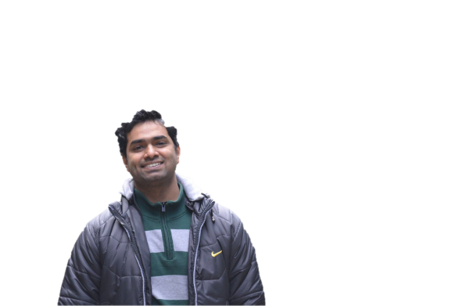
A LOOK BACK...’ALUMNI ‘..!!!
ANOOP RAVINDRAN (2013)
Program Manager at Microsoft
Bengaluru,Karnataka,India
Binny Mathew
Mtech from IIT Kharagpur
Govind Raj Gopalakrishnan
Associate Project Manager
HCL Technologies, USA
eBAY
INFOSYS
BOSCH
ACCENTURE
COGNIZANT
IBS
HP
ABB GISL
IBM
AMERICAN MEGATRENDS
SAP
SAMSUNG
SIEMENS
VERIZON…

Slide 16
LOOKING FOR A GOOD CAREER?
Infosys
https://www.infosys.com/careers/job-opportunities/
Accenture
https://www.accenture.com/in-en/careers
Cognizant
https://www.cognizant.com/careers
Intel
http://www.intel.com/content/www/us/en/jobs/locations/india.html
TCS
https://careers.tcs.com/careers/index.html#/careers/AS/IN
Facebook
https://www.facebook.com/careers/
Microsoft
https://careers.microsoft.com/
Dell
http://jobs.dell.com/in/india-jobs
Flipkart
http://www.flipkartcareers.com/
Wipro
http://careers.wipro.com/

Slide 17
FEW TIPS...
Focus on course work.
Study lot of discrete maths, linear algebra, algorithms & some machine learning
Do a lot of programming competitions
Try to master at least two programming languages, preferably one very low level language like C, one relatively high level language like Python, and get familiar with non-imperative paradigms of programming. More the merrier.
Use Linux, and learn to use shell effectively
Understand how internet works, learn a few basic web development technologies & using them design your own home page

Slide 18
INSTITUTION & DEPT HIGHLIGHTS
GOT 3 YEARS ACCREDITATION BY NATIONAL BOARD OF ACCREDITATION (NBA)
AMONG THE TOP 5 COLLEGES IN KERALA, RANKED 2nd BEST COLLEGE IN
KERALA BY CAREER 360
RANKED 3rd IN KTU 1st YEAR RESULT
COURSES: B.Tech, B.Arch, M.Tech & PhD
STRONG CSE DEPARTMENT WITH QUALITY FACULTY AND ONGOING
RESEARCH IN NETWORKING, BIOINFORMATICS AND DATA ANALYTICS

