Slide 1
GREAT PLACES TO WORK
MECHANICAL ENGINEERING
Prepared by
Arun O. Babu, Job Cherian, Roni George, Joel V. Thomas, Jim George

Slide 2
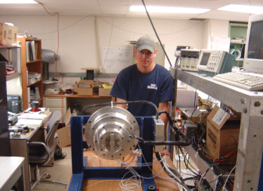
Mechanical Engineering
Mechanical engineering is one of broadest studies in engineering
The design and creation of mechanical technologies that benefit society
They utilize power to work with all types of mechanical devices, and all types of manufacturing and plant designs

Slide 3
.

Slide 5
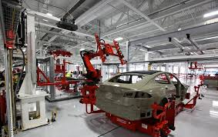
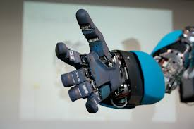
CAREER PATHS IN MECHANICAL ENGINEERING
Automobile Engineering
Energy & Utilities Industry
Robotics Engineering

Slide 6
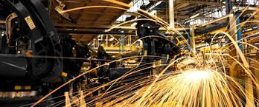
CAREER PATHS IN MECHANICAL ENGINEERING
Manufacturing
Bio Mechanical engineering
Microelectronic Mechanical systems

Slide 7
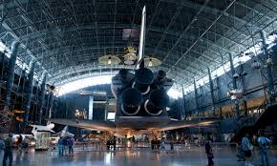
CAREER PATHS IN MECHANICAL ENGINEERING
Composite materials engineering
Nanotechnology
Aerospace Engineering

Slide 8
Major players

Slide 9
Major Players

Slide 10
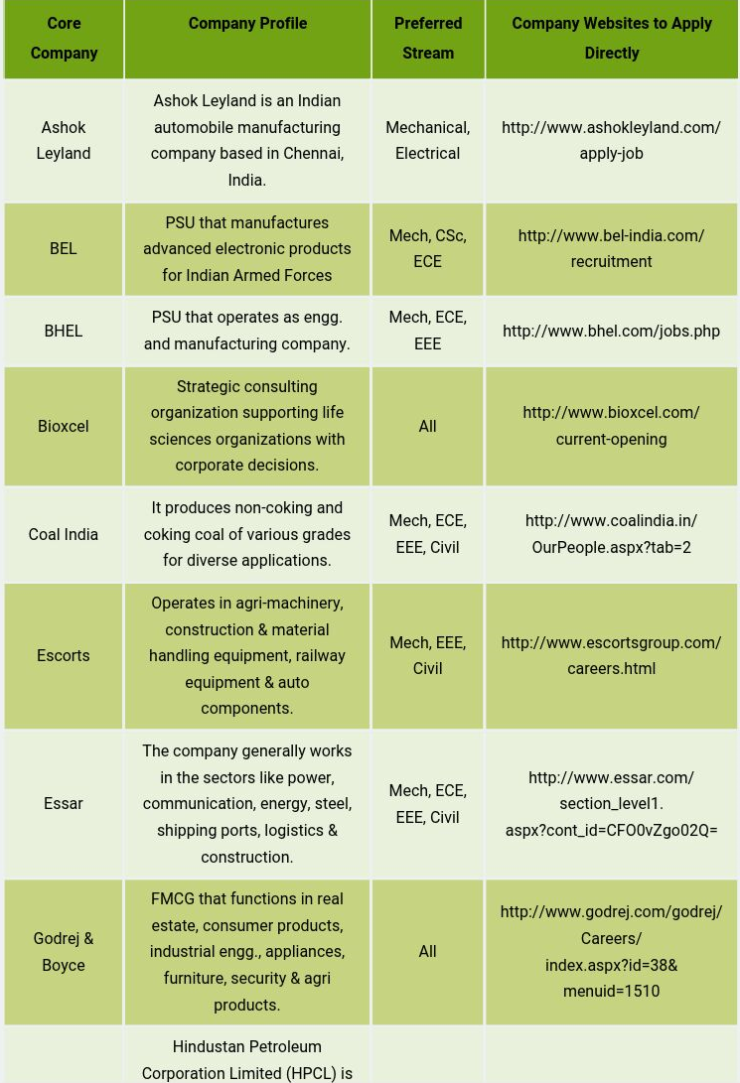

Slide 11
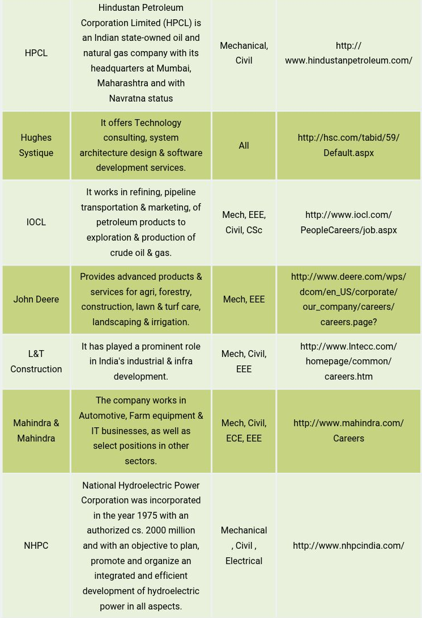

Slide 12
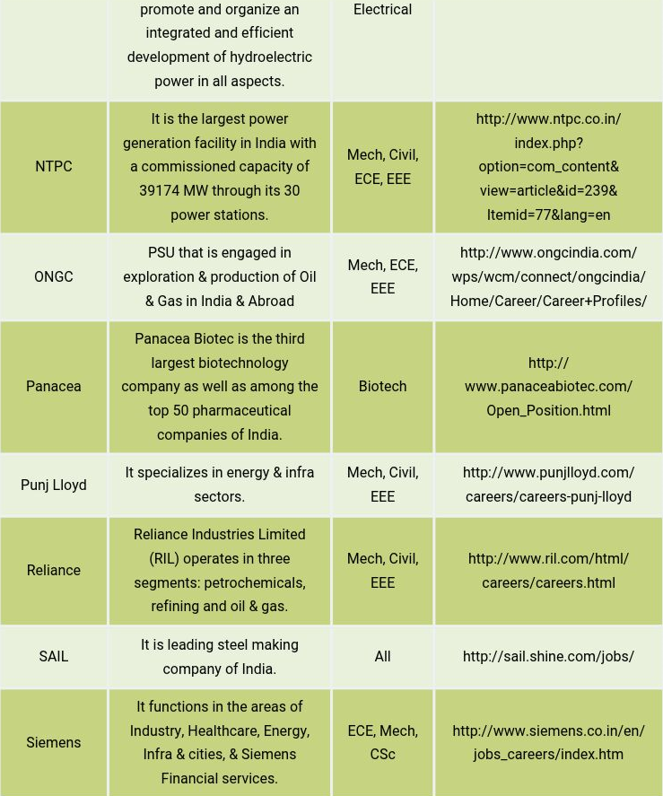

Slide 13
Career Paths as a Mechanical Engineer
Business Leadership Path
Technical Specialist Path
General Management / Operational Management Path

Slide 14
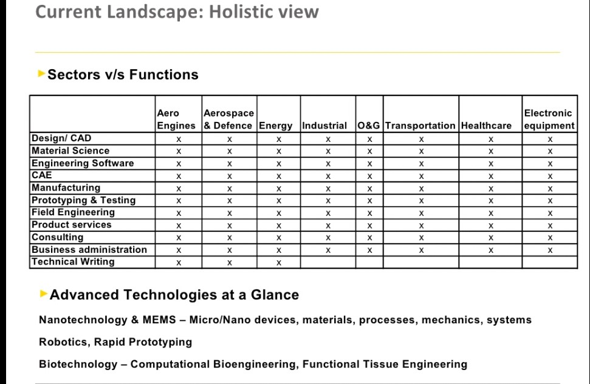

Slide 15
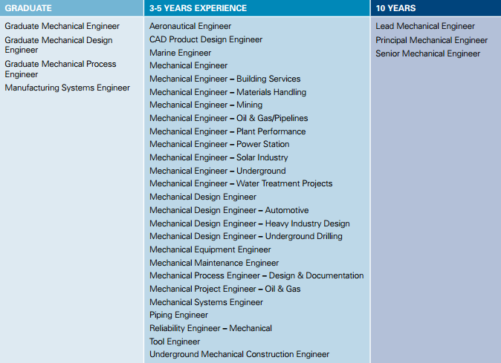
CAREER PROGRESSION

Slide 16
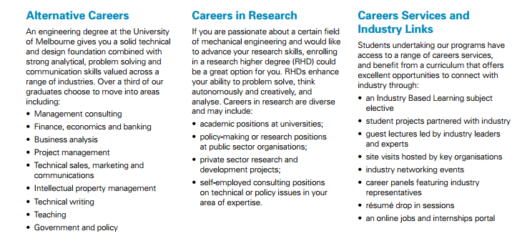

Slide 17
Plan your career : Choose your strokes

