Slide 1
CAREER GUIDE
Electrical and Electronics Engineering
Prepared by
Aravind P
Sharat Mohan
Sajith John Kaleekal

Slide 2
“Electrical science has revealed to us the true nature of light, has provided us with innumerable appliances and instruments of precision, and has thereby vastly added to the exactness of our knowledge.”
Nikola Tesla

Slide 3
Career Paths

Slide 5
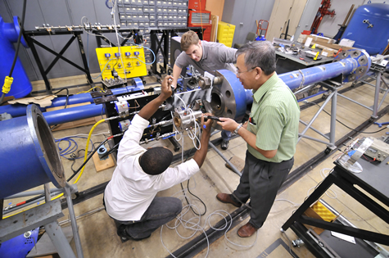

Slide 7
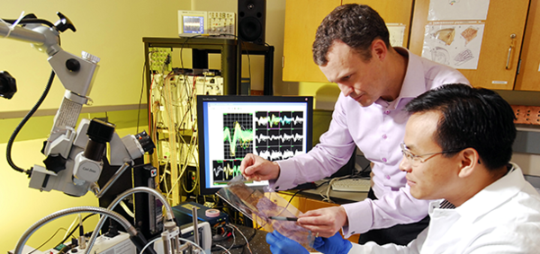
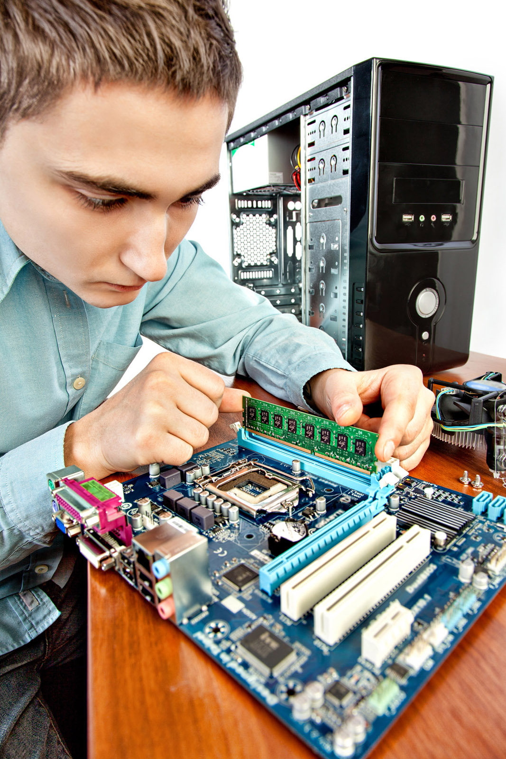

Slide 9
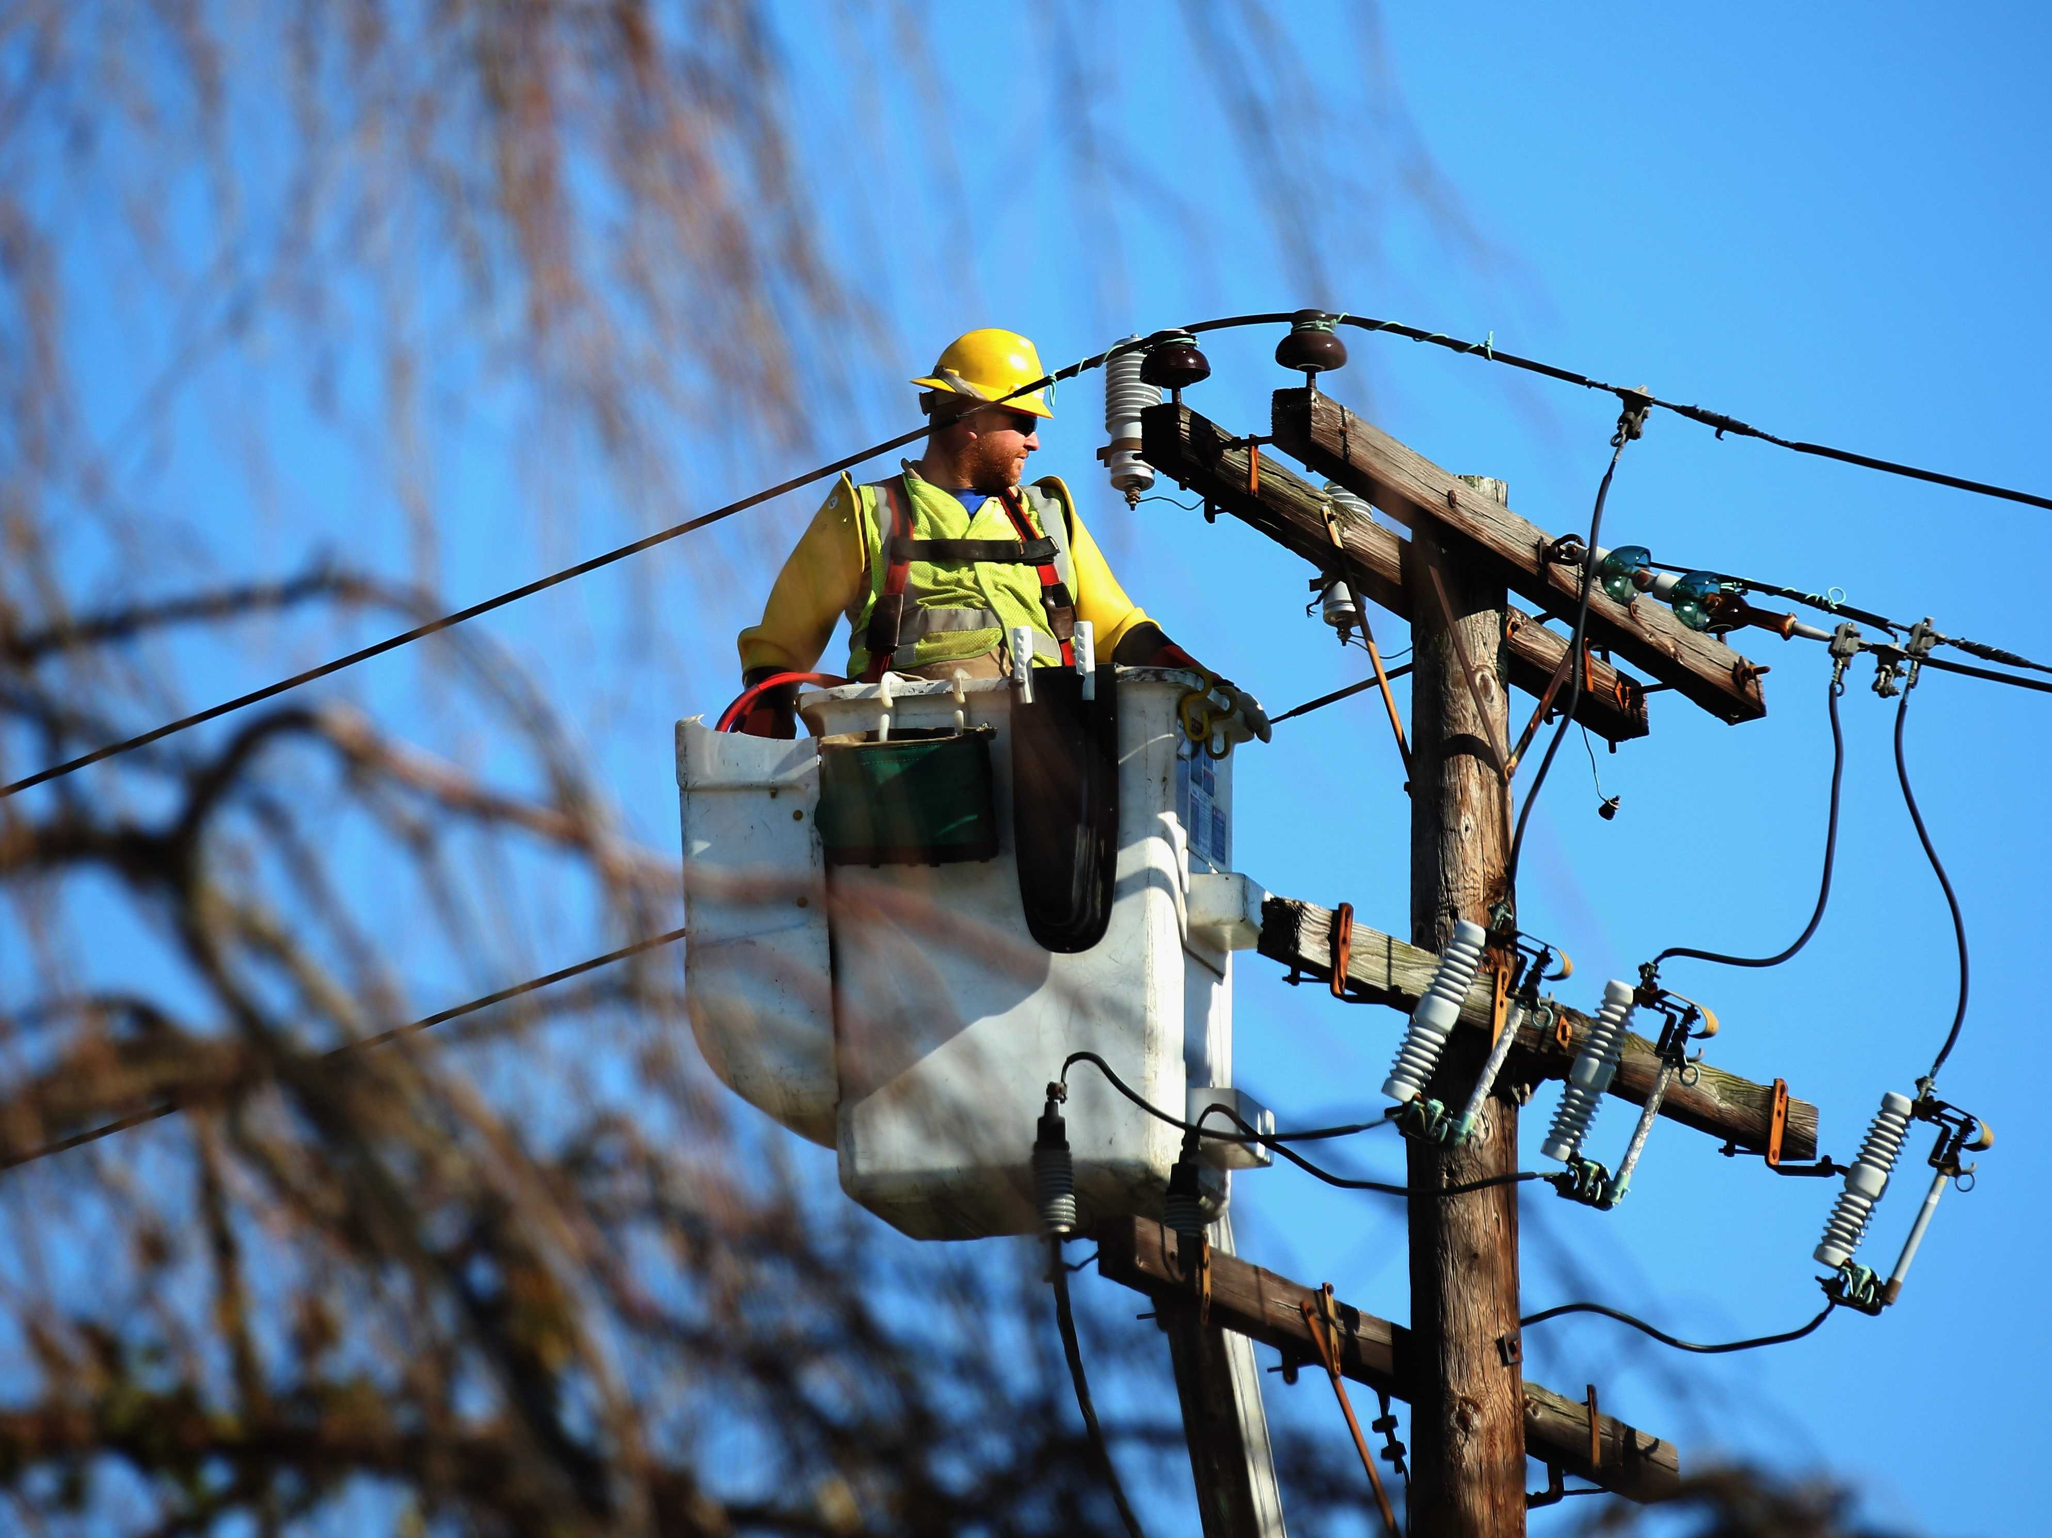

Slide 10
What after B.Tech?
B.Tech
IT Sector
Core Jobs
GATE
Higher Studies
Placement
Jobs
Core
Private Sector
Public Sector
MTECH
Research
Teaching
PhD
MBA
Jobs
Other Tests
UPSC, PSC
Defence service
Railways, PSUs etc.

Slide 11
Top Private Sector Companies:
Alstom
ABB
Larsen & Toubro (L&T)
Crompton Greaves Ltd.
Bajaj Electricals Ltd.
Siemens India
Tata Steel
HBL Power Systems Ltd.
Schweitzer Engineering
Spectrum Power Generation Ltd.
HBL Power Systems Ltd.
Tata Motors
Jindal Steel & Power Ltd.

Slide 12
Top Public Sector Undertakings:
National Thermal Power Corporation Ltd.
Hindustan Petroleum Corporation Ltd.
National Aluminium Company Ltd.
Gas Authority of India Ltd.
Indian Oil Corporation Ltd.
Heavy Engineering Corporation Ltd.
National Fertilizers Ltd.
Container Corporation of India Ltd.
National Hydroelectric Power Corporation

Slide 13
Higher Study After Electrical Engineering
If you are not interested in doing job just after graduation, then you can opt for some higher studies like MBA or M.Tech. in specific field. For admission in MBA, aspirant has to qualify CAT or similar exam.
On the other hand if you would like to opt for M.Tech., then the candidate has to score well in GATE. You can also go for job and study simultaneously by opting distance learning.
After electrical engineering, students can try some job oriented courses or can have short term training to get specialized in the field of interest.

Slide 14
Jobs Abroad
There are a large number of employment opportunities for electrical engineers in overseas. This is because of the presence of various manufacturing firms outside India. Electrical Engineers who are specialized in Control & Power Systems can find good opportunities in Japan, Germany, US & Korea. Electrical Design Engineers also can try their luck in multidisciplinary engineering consultancies.

Slide 15
Alumni (some highlights)
Bosch Najid Ali M
ISRO
Sharjah Electricity and Water Authority
Geethu Sankar
Hareesh R
AJITH.S.L.
Government of Kerala Jayarajan A V Sreelekha V Dr. Jaison Mathew
KSEB
AKHIL C
ANISH A
VISHNU PRASAD
Union Bank of India
NITHIN K
IISC Bangalore Arun Rahul S
TCS
VIVEK S
South Indian Bank
Serco Middle East - Dubai Metro
General Electric (GE)
Mahesh Raveendranatha Panicker
ARPITHA TOM MATTAKOTTIL
Binu Philip Mathew

Slide 16
Career (links)
Ministry of Human Resource Development, Govt of India mhrd.gov.in
Department of Higher Education, Govt of Kerala www.highereducation.kerala.gov.in
Directorate of Technical Education, Govt of Kerala www.dtekerala.gov.in
Confederation of Indian Industry, Kerala www.cii.in
Department of Industries, Govt of Kerala www.keralaindustry.org
Technopark, Trivandrum www.technopark.org
Infopark, Kochi www.infopark.in
Kerala Startup Mission startupmission.kerala.gov.in
Startup Village www.sv.co.in
10,000 Startups 10000startups.com
Indian Entrepreneur www.indianentrepreneur.com
Science & Technology, Govt of India https://india.gov.in/topics/science- technology/scientific-education
Centre for Engineering Research and Development, Govt of Kerala www.dtekerala.gov.in
Kerala State Council for Science, Technology & Environment, Govt of Kerala www.kscste.kerala.gov.in

Slide 17
Institution (Highlight)
One of the top five engineering colleges in Kerala.
College accredited for 3 years by NBA (with effect from Jan 2016).
Stood 3rd in the State for 1st year B.Tech results of APJKTU .
Well equipped sports facilities including football court, basket ball court, other indoor games and a multi gym.
Active cells of IEEE, ISTE and SAE in the college.
Digitalised and fully equipped central library

Slide 18
FEW TIPS...
Placements are like the passport to employment after B.Tech. So be part of
placement drives
Students aspiring GATE should concentrate and work hard for it.
Saying yes to higher studies is not at all a bad decision
Our country even need civil servants and government employees from you
guys
GOOD LUCK

Slide 19
We power the world!

Slide 20
Thanks!
For feedbacks we are available at
http://www.rit.ac.in/cgpcn/feedback.php

